Slide 1
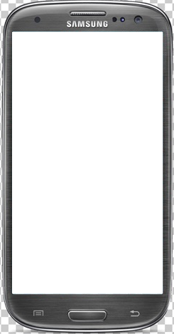
Match & Learn
Jugar
Instrucciones
powered by The Android Guys

Slide 2





